Slide 1
Actually using and configuring Avida
Lecture 11
Oct 11, 2010

Slide 2
Basic files
avida.cfg – basic configuration (size, topology, etc.)
events.cfg – monitoring and actions
environment.cfg – resources
default-heads.org – default organism
instset-heads.org – instruction set / string translation

Slide 3
Your challenge
Frame your LTEE-like experiment in computational terms.
Write down configuration file “deltas” (sets of changes to make to the default configs) and the sequence of actions to perform for your proposed experiment.
Also think about measurements.

Slide 4
Reference documentation
Available at http://lyorn.idyll.org/~t/avida/

Slide 5
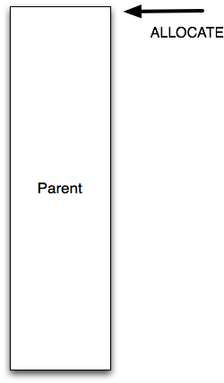
The copy loop

Slide 6
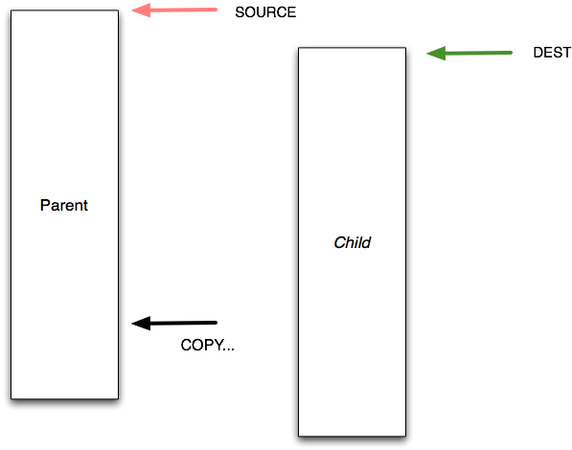

Slide 7
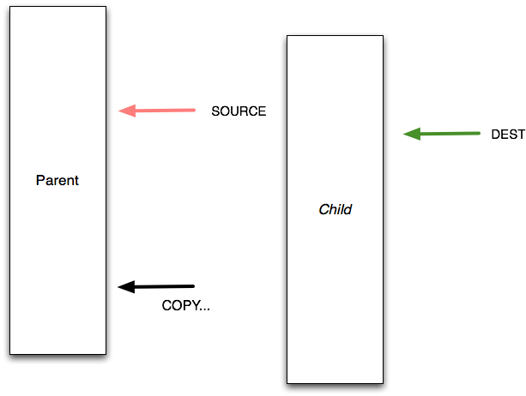

Slide 8
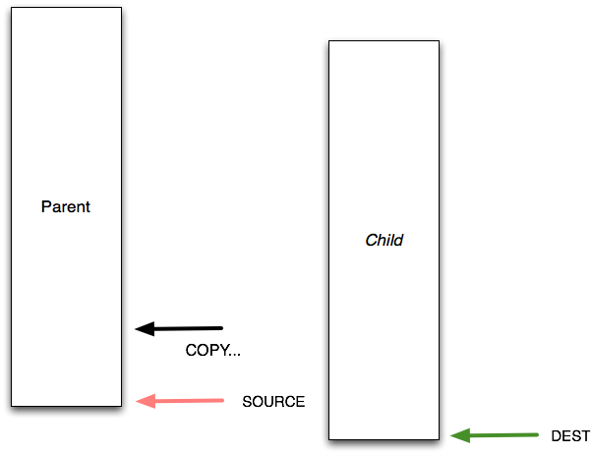

Slide 9
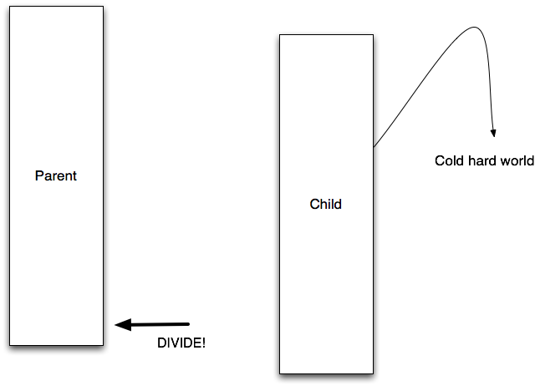

Slide 10
Allocation @ beginning
h-alloc # Allocate space for child
h-search # Locate the end of the organism
nop-C #
nop-A #
mov-head # Place write-head at beginning of offspring.
…
nop-A # End label.
nop-B #

Slide 11
Copy loop (at end)
h-search # Mark the beginning of the copy loop
h-copy # Do the copy
if-label # If we're done copying....
nop-C #
nop-A #
h-divide # ...divide!
mov-head # Otherwise, loop back to the beginning of the copy loop.

Slide 12
Selecting a starting organism, or injecting one
avida.cfg:
START_CREATURE default-heads.org
or events.cfg:
InjectSequence …
(and other commands)

Slide 13
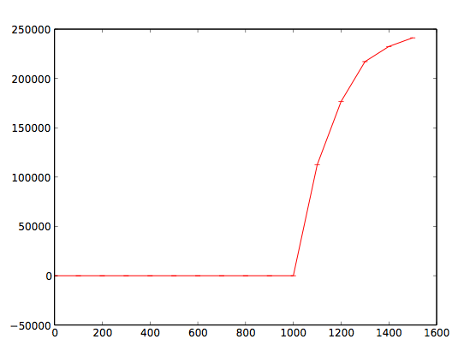
Injecting “bonecrusher”

Slide 14
events.cfg
# syntax: [trigger] [start:interval:stop] [action/event] [arguments...]
u 20000 Exit
u 0:100:end PrintDominantData
See “List of Actions” for more info:
http://lyorn.idyll.org/~t/avida/events.html
http://lyorn.idyll.org/~t/avida/actions.html

Slide 15
Transferring organisms
Select from dominant?
Look at dominant.dat
Retrieve dominant org genotype
Configure as starting org, or inject, or whatnot.
Randomly from population?
Use event ‘SavePopulation’
Write script to randomly choose N critters
Inject!

Slide 16
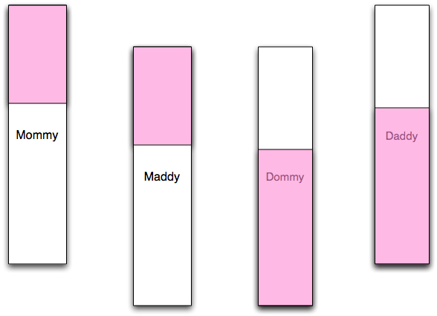
Turning on sex (recombination)

Slide 17
Turning on sex (recombination)
Swap an instruction into the instruction set:
divide-sex instead of h-divide
This allows critters to make use of recombination.
(You can leave both in there, too.)
instset-heads.cfg:
nop-A 1 # a
…
h-divide 1 # x

Slide 18
Turning on sex (recombination)
2. Configure recombination options in avida.cfg:
RECOMBINATION_PROB (defaults to 1.0: 100% probability of recombination)
TWO_FOLD_COST_SEX (defaults to 2 parents, 2 offspring)

Slide 19
Resources
environments.cfg:
RESOURCE glucose:initial=10000
RESOURCE maltose:initial=10000:inflow=100:outflow=0.01
See:
http://lyorn.idyll.org/~t/avida/environment.html

Slide 20
Interconversion
environments.cfg:
RESOURCE yummyA:initial=1000 RESOURCE yummyB:initial=1000
REACTION AtoB gobbleA process:resource=yummyA:frac=0.001:product=yummyB
REACTION BtoA gobbleB process:resource=yummyB:frac=0.001:product=yummyA
But you have to also have gobbleA and gobbleB tasks…

Slide 21
Default: no depletable resources
environments.cfg:
REACTION NOT not process:value=1.0:type=pow requisite:max_count=1
REACTION NAND nand process:value=1.0:type=pow requisite:max_count=1
REACTION AND and process:value=2.0:type=pow requisite:max_count=1
…

Slide 22
Depletable resources
environments.cfg:
RESOURCE glucose:initial=10000
REACTION NOT not process:resource=glucose:value=1.0:type=pow requisite:max_count=1

Slide 23
Interconvertible resources
environments.cfg:
RESOURCE glucose:initial=10000
RESOURCE sucrose:initial=0
REACTION NOT not process:value=1.0:type=pow:resource=glucose:product=sucrose requisite:max_count=1
REACTION NAND nand process:value=1.0:resource=sucrose:type=pow requisite:max_count=1

Slide 24
More on resources
Be careful about your setup.
Run it a few times and figure out what’s going on.
…maybe with a hand-designed critter?
Use PrintResourceData to monitor (in events.cfg)

Slide 25
Other config parameters
avida.cfg:
WORLD_GEOMETRY – 2D or ..
BIRTH_METHOD – random replacement, or geriatricide, or …
events.cfg:
Exit

Slide 26
Some example scripts
Modify a config parameter
Transfer an organism
Decode an organism from string to genome

Slide 27
What’s next?
Fit your proposed project to Avida’s capabilities.
Identify starting config parameters
Describe process
We’ll (help) develop scripts for that.

